Slide 1
Hotel Reservation Analysis with SQL
By M Jazlan Samad Data analyst intern
Batch – MIP-DA-10

Slide 2
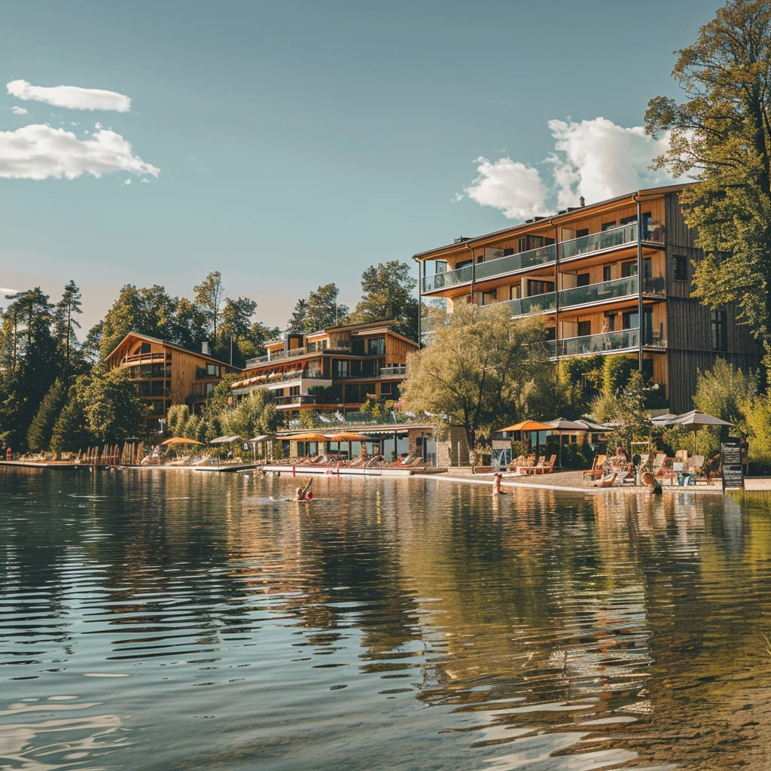
Table of contents
Introduction
Dataset details
Queries to analyze the hotel reservation dataset
Data Preparation
SQL Queries and The Result
Insight And Recommendation

Slide 3
Introduction
The hotel industry relies on data to make informed decisions and provide a better guest experience
In this presentation, we will explore various aspects of hotel reservations and insights that can help in understanding customer behavior and improving service delivery. Our goal is to provide a comprehensive overview of the data, highlighting and offering actionable recommendations for enhancing the overall guest experience.
This analysis is based on a detailed dataset of hotel reservations, encompassing information such as booking status, room types, customer demographics, and stay durations. By examining this data, we aim to uncover valuable insights that can inform strategic decisions and drive better business outcomes.

Slide 4
Dataset description
The dataset includes the following columns:
• Booking_ID: A unique identifier for each hotel reservation.
• no_of_adults: The number of adults in the reservation.
• no_of_children: The number of children in the reservation.
• no_of_weekend_nights: The number of nights in the reservation that fall on weekends.
• no_of_week_nights: The number of nights in the reservation that fall on weekdays.
• type_of_meal_plan: The meal plan chosen by the guests.
• room_type_reserved: The type of room reserved by the guests.
• lead_time: The number of days between booking and arrival.
• arrival_date: The date of arrival.
• market_segment_type: The market segment to which the reservation belongs.
• avg_price_per_room: The average price per room in the reservation.
• booking_status: The status of the booking.

Slide 5
Queries to analyze The Hotel Reservation dataset
1. What is the total number of reservations in the dataset?
2. Which meal plan is the most popular among guests?
3. What is the average price per room for reservations involving children?
4. How many reservations were made for the year 20XX (replace XX with the desired year)?
5. What is the most commonly booked room type?
6. How many reservations fall on a weekend (no_of_weekend_nights > 0)?
7. What is the highest and lowest lead time for reservations?
8. What is the most common market segment type for reservations?
9. How many reservations have a booking status of "Confirmed"?
10. What is the total number of adults and children across all reservations?
11. What is the average number of weekend nights for reservations involving children?
12. How many reservations were made in each month of the year?
13. What is the average number of nights (both weekend and weekday) spent by guests for each room type?
14. For reservations involving children, what is the most common room type, and what is the average price for that room type?
15. Find the market segment type that generates the highest average price per room.

Slide 6
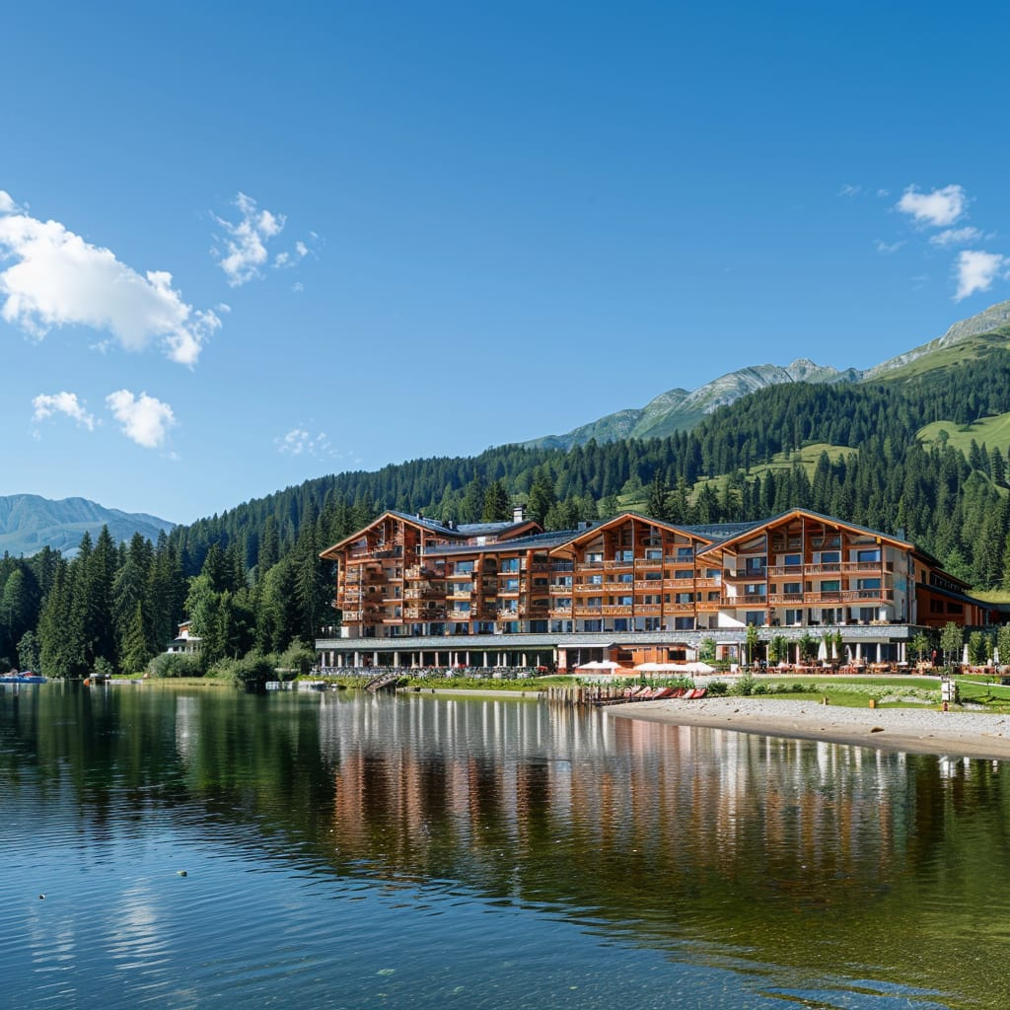
Data Preparation

Slide 7
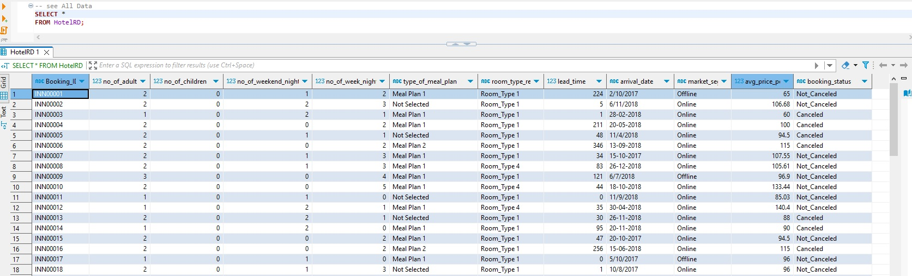
Data Preparation
Dataset overview

Slide 8
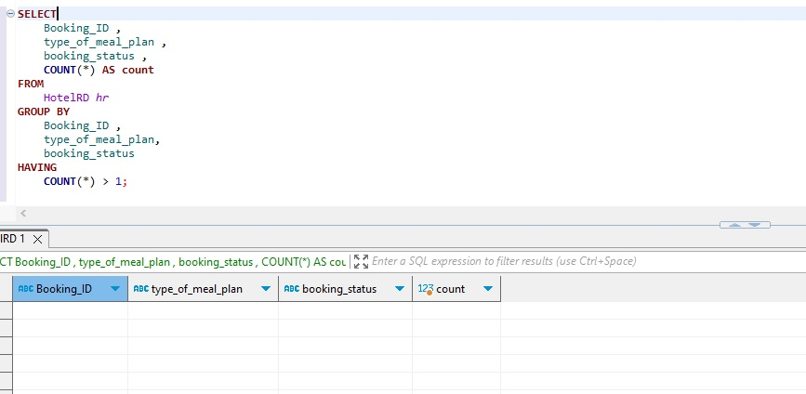
Data Preparation
Check Data Duplication – No Duplication Data

Slide 9
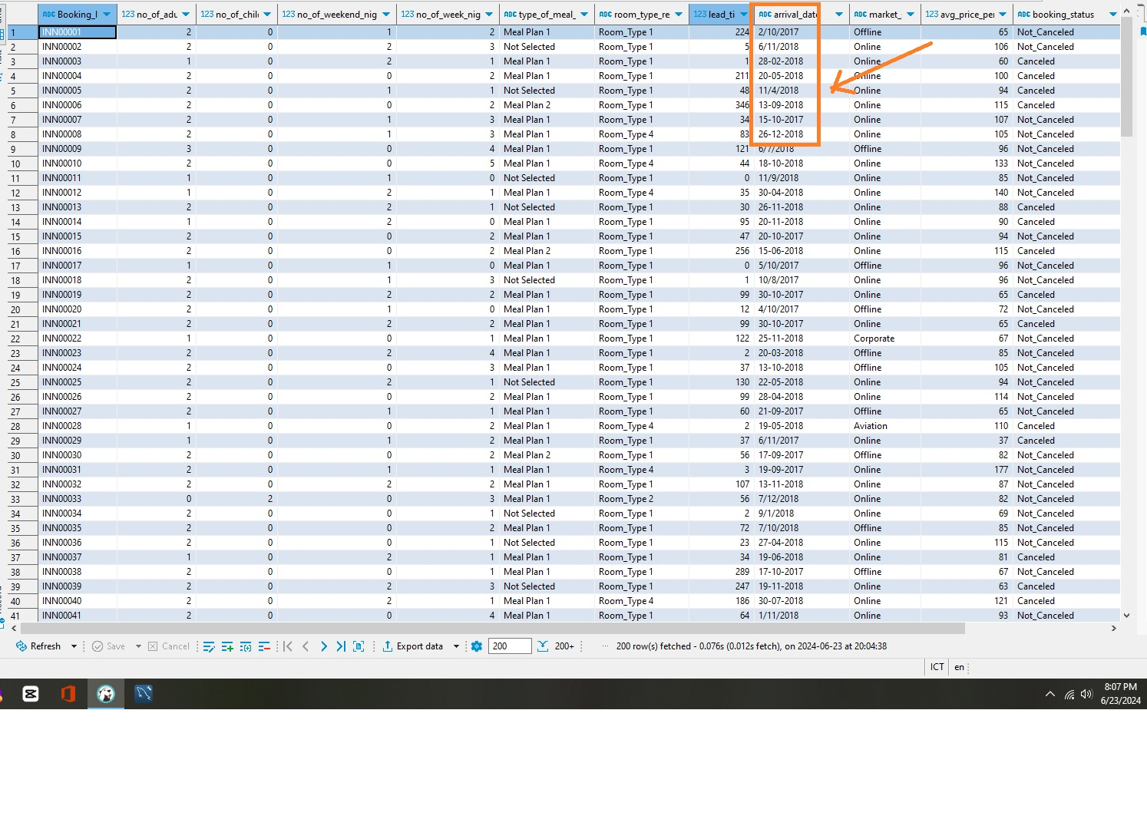
Data Preparation
Check Data Format Standardization, need to change date format

Slide 10
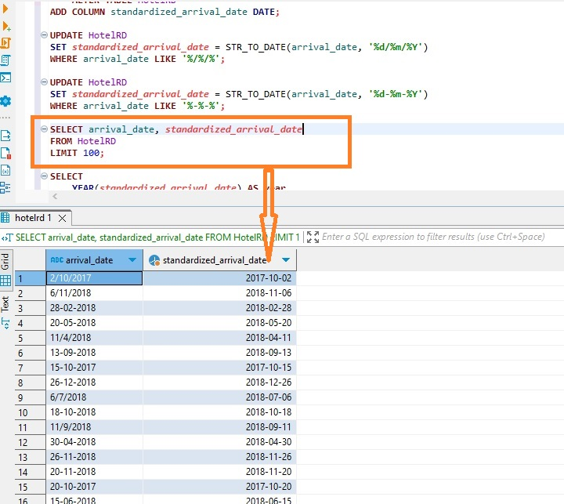
Data Preparation
Adding Column with the same date Format

Slide 11
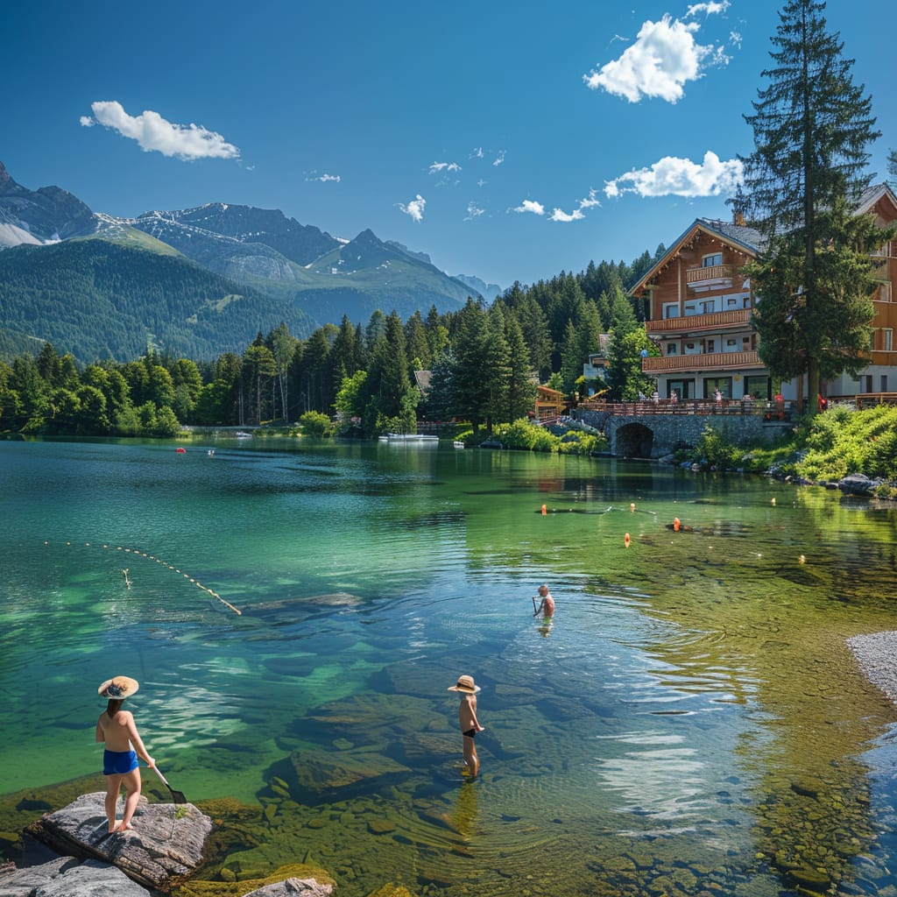
SQL Queries and The Result

Slide 12
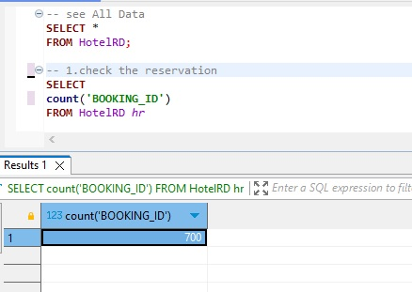
SQL Queries and The Result
1. What is the total number of reservations in the dataset?
Result : 700

Slide 13
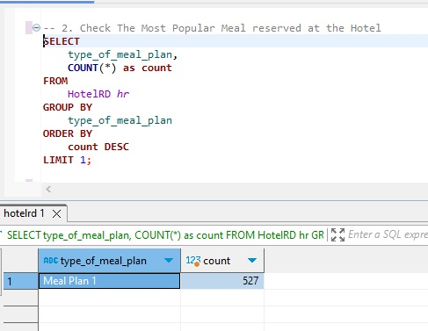
SQL Queries and The Result
2. Which meal plan is the most popular among guests?
Result : Meal Plan 1 with 527 counts

Slide 14
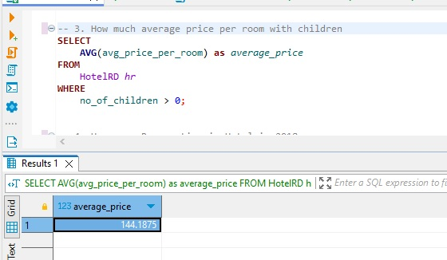
SQL Queries and The Result
3. What is the average price per room for reservations involving children?
Result : $ 144.1875

Slide 15
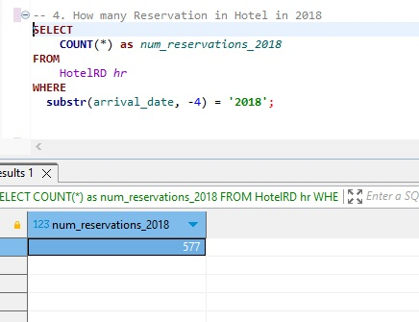
SQL Queries and The Result
4. How many reservations were made for the year 2018 ?
Result : 577 reservations

Slide 16
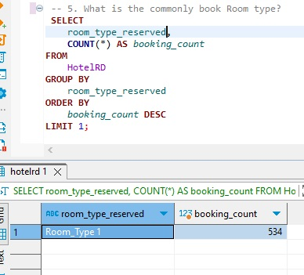
SQL Queries and The Result
5. What is the most commonly booked room type?
Result : Room Type 1

Slide 17
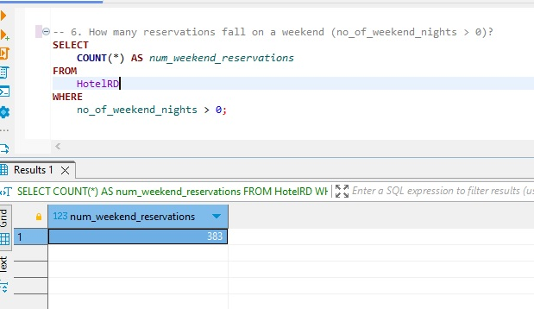
SQL Queries and The Result
6. How many reservations fall on a weekend (no_of_weekend_nights > 0)?
Result : 383 reservations

Slide 18
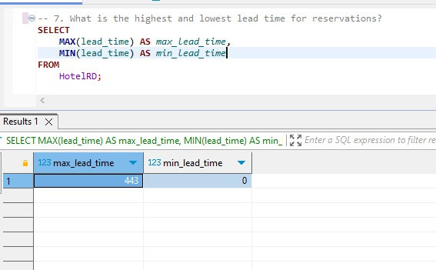
SQL Queries and The Result
7. What is the highest and lowest lead time for reservations?
Result : Max : 443 , Min : 0

Slide 19
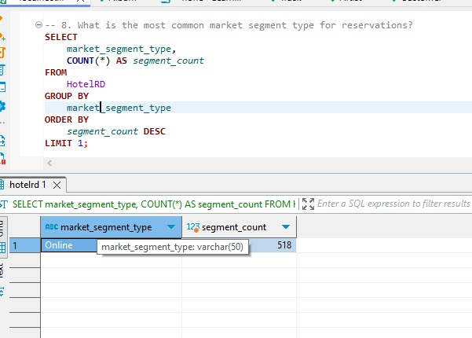
SQL Queries and The Result
8. What is the most common market segment type for reservations ?
Result : Online with 518 Counts

Slide 20
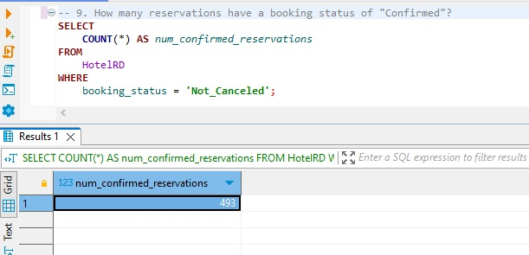
SQL Queries and The Result
9. How many reservations have a booking status of "Confirmed"?
Result : 493 reservations

Slide 21
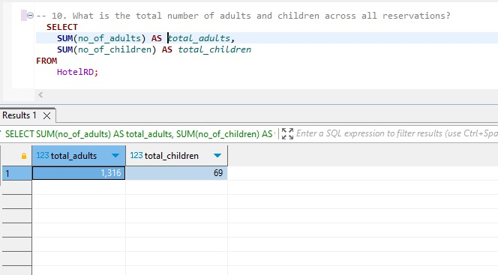
SQL Queries and The Result
10. What is the total number of adults and children across all reservations?
Result : Adults = 1316, children = 69

Slide 22
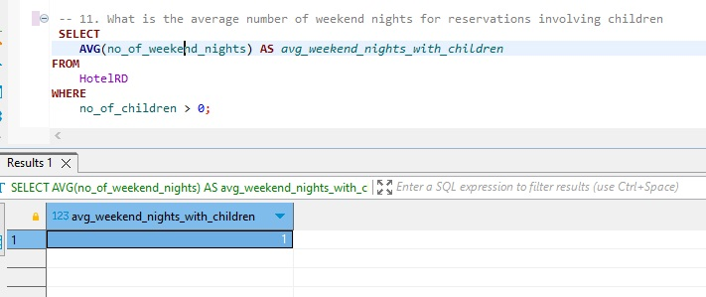
SQL Queries and The Result
11. What is the average number of weekend nights for reservations involving children?
Result : 1 night

Slide 23
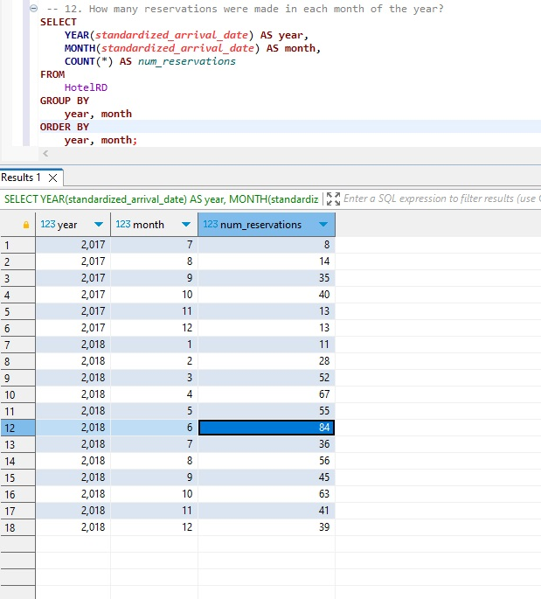
SQL Queries and The Result
12. How many reservations were made in each month of the year?
Result : see the query

Slide 24
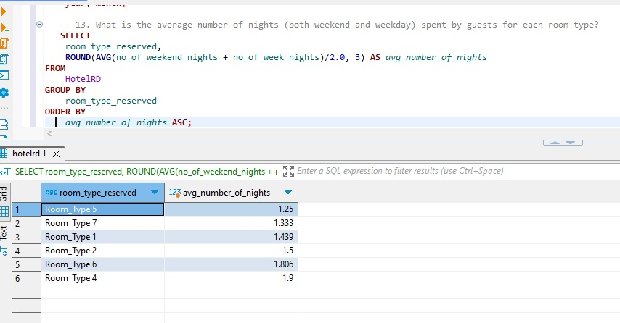
SQL Queries and The Result
13. What is the average number of nights (both weekend and weekday) spent by guests for each room type?
Result : see the query

Slide 25
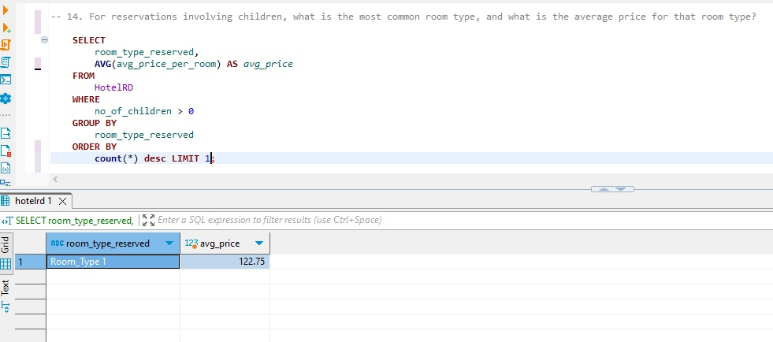
SQL Queries and The Result
14. For reservations involving children, what is the most common room type, and what is the average price for that room type?
Result : Room_type 1. average price = $122.75

Slide 26
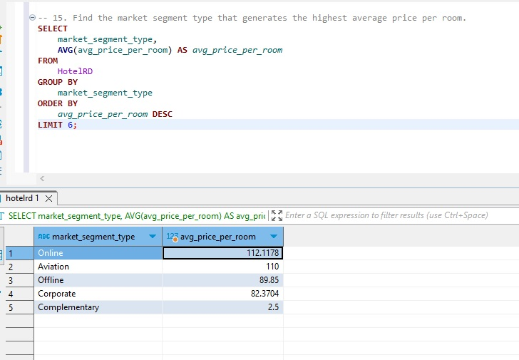
SQL Queries and The Result
15. Find the market segment type that generates the highest average price per room.
Result : Online is the market segment that generates the highest average price.

Slide 27
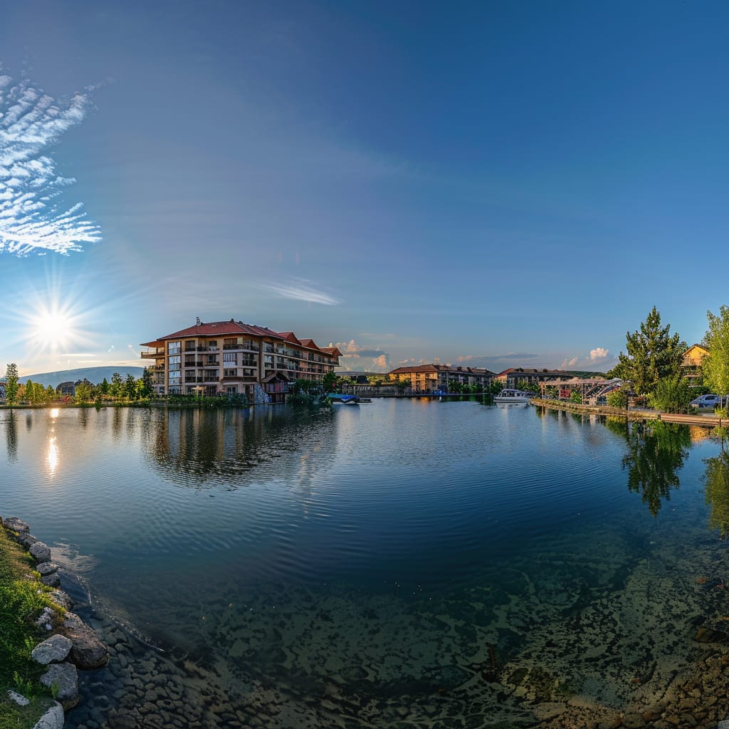
Insight and Recommendation

Slide 28
Insight and Recommendation
Total Reservations:
Insight: The dataset contains a total of 700 reservations.
Recommendation: Given the volume of data, trends and patterns can be reliably identified
to improve operational efficiency and customer satisfaction.
Popular Meal Plan:
Insight: Meal Plan 1 is the most popular, with 527 counts.
Recommendation: Focus on promoting and possibly expanding Meal Plan 1 offerings,
as it is clearly preferred by guests. Consider investigating why this meal plan is so popular to
enhance other meal plans similarly.
Average Price for Reservations Involving Children:
Insight: The average price per room for reservations involving children is $144.19.
Recommendation: Tailor packages and promotions for families, possibly including children’s
activities or family discounts to attract more family bookings.
Reservations in 2018:
Insight: In 2018, there were 577 reservations.
Recommendation: Analyze the reasons behind the high number of reservations in 2018
to replicate and improve on those strategies in future years.

Slide 29
Insight and Recommendation
Most Commonly Booked Room Type:
Insight: Room Type 1 is the most commonly booked, with 534 reservations.
Recommendation: Ensure sufficient availability and quality maintenance of Room Type 1.
Consider if the features of Room Type 1 can be applied to other room types to increase their popularity.
Weekend Reservations:
Insight: 383 reservations involve weekend nights.
Recommendation: Develop special weekend packages or promotions to capitalize
on the high demand for weekend stays. Consider offering extended check-out times or additional
services for weekend guests.
Lead Time for Reservations:
Insight: The highest lead time is 443 days, and the lowest is 0 days.
Recommendation: Create a dynamic pricing strategy based on lead time. Offer early bird discounts
for high lead times and last-minute deals for low lead times to maximize occupancy and revenue.
Common Market Segment Type:
Insight: The online market segment is the most common, with 518 reservations.
Recommendation: Focus marketing efforts on online channels, optimize the website for better
user experience, and leverage social media and online travel agencies to attract more bookings.

Slide 30
Insight and Recommendation
Confirmed Reservations:
Insight: There are 493 confirmed reservations.
Recommendation: Streamline the booking and confirmation process to maintain or improve this high
confirmation rate. Ensure the booking process is user-friendly and efficient.
Total Adults and Children:
Insight: There are 1316 adults and 69 children across all reservations.
Recommendation: While adults are the primary demographic, consider increasing family-friendly
amenities and promotions to attract more bookings involving children.
Average Weekend Nights for Reservations Involving Children:
Insight: The average number of weekend nights for reservations involving children is 1.
Recommendation: Create family weekend packages that include activities for children, enhancing
the experience and potentially increasing the length of stay.
Monthly Reservations:
Insight: Reservations peak in certain months (e.g., March, April, June).
Recommendation: Identify the reasons behind these peaks (e.g., holidays, events) and create
targeted marketing campaigns to boost reservations in off-peak months.

Slide 31
Insight and Recommendation
Average Nights Spent by Room Type:
Insight: Room Type 5 has the shortest average stay (1.25 nights), and
Room Type 4 has the longest (1.9 nights).
Recommendation: Adjust room pricing and marketing strategies based on the average
length of stay. Consider offering discounts for extended stays in room types with shorter average stays.
Common Room Type and Average Price for Reservations Involving Children:
Insight: The most common room type for reservations involving children has an average price of $122.75.
Recommendation: Ensure these room types are family-friendly and consider adding amenities
or services that cater specifically to families.
Highest Average Price per Room by Market Segment:
Insight: The online market segment generates the highest average price per room ($112.12).
Recommendation: Focus on enhancing the online booking experience and consider premium
online-only offers to capitalize on this high-revenue segment.
Additionally, investigate ways to increase the average price in other segments.

Slide 32
Thank You

